Slide 1
Time-processing ability and Daily Time Management and Time aids
GUNNEL JANESLÄTT 2014

Slide 2
Introduction
In the time-dependent society of today, persons with limited ability to manage time will show a heightened dependence on others and more need for support, exacerbating their inferior role and vulnerability

Slide 3
What does it take to use the information you get from the clock?
To interpret the clockface /understand digital time
Knowing next important event
To understand time quantity
To calculate differences and add up time periods
To know WHAT you will have time to do in the set time
To understand and use time concepts
To compare alternatives

Slide 4
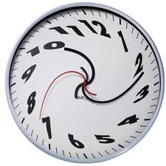
Persons with
Attention Deficit Hyperactivity Disorder, ADHD children (Smith 2002; Abilkoff et al 2013) and adults (Barkley, Murphy, & Bush, 2001; Asherson, Akehurst et al. 2012; Adler and Chua 2002; Carelli and Wiberg 2012; Valko, Schneider et al. 2010; Young and Bramham 2000)
Asperger Syndrome or high functioning Autism (Szelag, Kowalska, Galkowski, & Poppel, 2004; Claessens, van Eerde et al. 2007; Bramham, Ambery et al. 2009)
Intellectual Disability (Arvidsson 2006; Davies 2002;Owen 2006; Janeslätt et al 2010)
Physical disability; CP, MMC (Donlau et al; 2008, 2009, 2010)
Psychiatric illness (Melges in Block 1990; Janeslätt Lindstedt, Adolfsson, 2014) )
Older students learning disabilities (Manganello 1994)
often demonstrate problems in time perception,
time orientation and time management, thus in Dailý time managenent

Slide 5
ICF-CY Definitions of concepts of time (WHO 2010)
Time perception is the experience of time; specifically the mental functions related to the subjective experiences of the length and passage of time [b1802] (WHO, 2010)
Orientation in time is related to awareness of the day, date, month and year [b1140] (WHO, 2010) a person’s awareness of and ability to understand physical time (Eisler, 2003; Kylén, 1984)
Time management is the mental function of ordering events in chronological sequence and allocating amounts of time to events and activities [b1642](WHO, 2010)

Slide 6
In ICF-CY time at Activity/participation level
Managing one’s time [d2305] managing the time required to complete usual or specific activities, such as preparing to depart from the home and accessing assistive technology and supports time in daily life.
Adapting to time demands [d2306] Carrying out actions and behaviours appropriately in the required sequence and within the time allotted, such as running to the station when in danger of missing the train.
Managing one’s time and Adapting to time are summated into Daily time management
All time aids have the purpose to increase daily time management.

Slide 7
Instruments & concepts ICF-CY (WHO 2010)
Environment
Daily time management
Person
factors
Time-Parent Scale
Assessment of Time Management Skills
Time management
Time orientation
Time-processing ability, (TPA)
Time perception
KaTid-Child
KaTid Youth
© Time for Time (Janeslätt, 2009)
www.katid.se

Slide 8
Time-processing ability, definitions (WHO 2010)
Ordering events in chronological sequence, allocating amounts of time to events and activities, and is a is a super ordinate concept, part of higher-level cognitive functions. ”Timing”
To use aids for orientation in time e.g. the clock, calendar. Time perspektive. Amounts of time, number of days in a week, a month etc.
The mental functions that produce awareness of today, tomorrow, yesterday, date, month and year
The specific mental functions of the subjective experiences related to the length and passage of time.
The perception of the duration of activities
TIME
MANAGEMENT [b1642]
Teenages
ORIENTATION in
TIME [b1140]
School years
Experience of time/
Time perception [b1802]
Pree school years
Notes:
8
ADHDstudien G Janeslätt 2012-09-30
8

Slide 9
Examples of lacking time-processing ability
Time perception – For HOW LONG? ”Always worried about time or bound to strong routines.”
Orientation in time – WHEN? ”Uncomfortable solutions like waiting for hours in front of the TV.”
Time Management – Knowing WHAT, WHEN and FOR HOW LONG, ”You can´t plan your day and is developing a strong dependence.”

Slide 10
Examples of what could be done, ”Managing one’s time”
Time perception – For HOW LONG? ”Showing a certain visual time and how it increase.”
Orientation in time – WHEN? ”Showing planned events in a visual way.”
Time Management – ”Using adapted calenders or smartphones.”

Slide 11
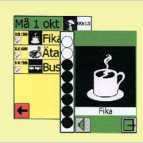
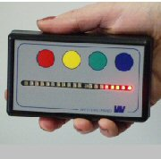
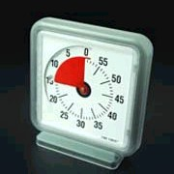
Time aids for time perception
Exampel:”For how long shall I wait?”
Showing how long time left
Time increase in steps. Time increase as a sektor
Gunnel Janeslätt
18 February 2015
11
Notes:
11

Slide 12
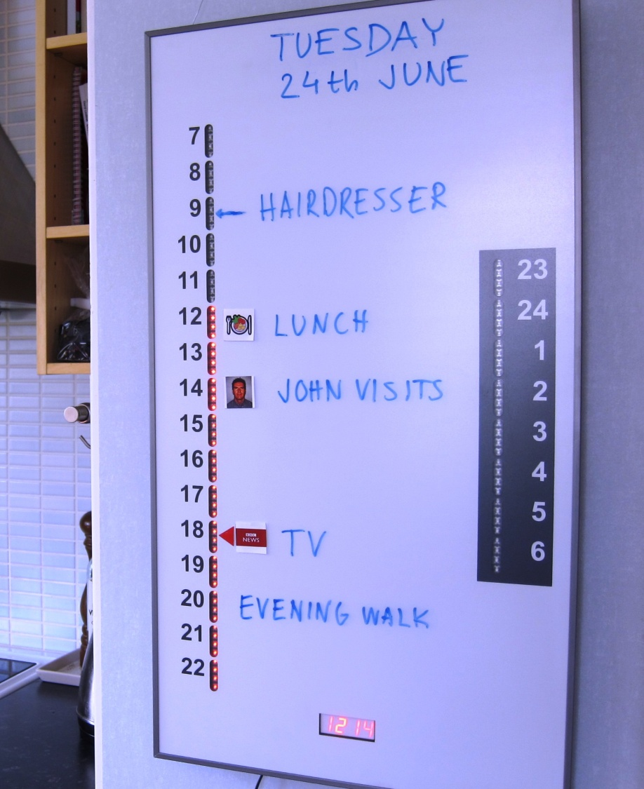
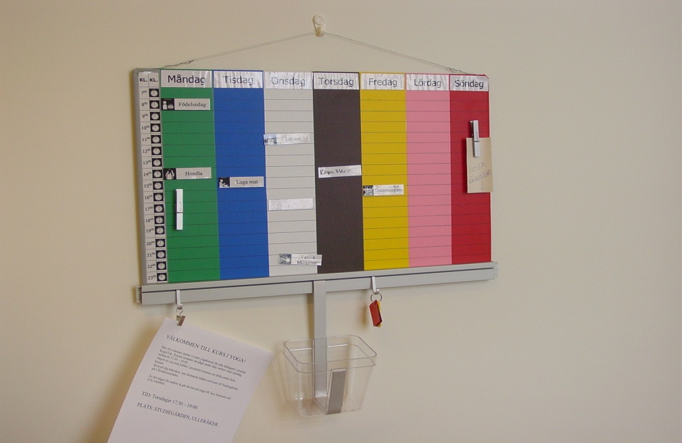
Time aids – time orientation
WHEN shall I…?
Overview of the week… Overview of a day with a time pillar
18 February 2015
Gunnel Janeslätt
12
Notes:
12

Slide 13
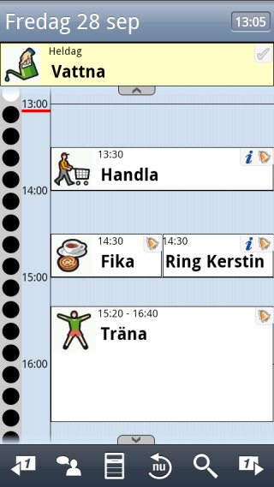
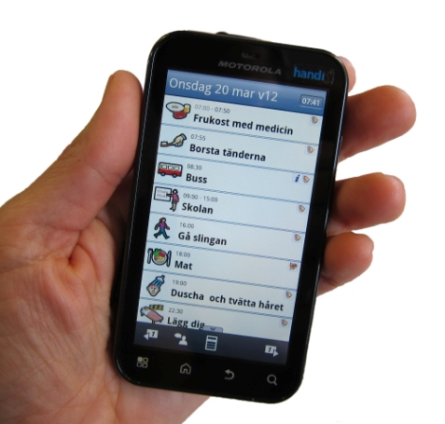
Time aids for time management
Reminder and calendar for daily time management
Gunnel Janeslätt
18 February 2015
13
Notes:
13

Slide 14
Compensatory intervention; examples of time aids at different levels of time-processing ability

Slide 15
Instruments
There are validated instruments to assess
Time-processing ability: KaTid-Child, KaTid-Youth
Daily time management: Time-Self rating scale
Organization Time Management and Planning (OTMP): COSS or ATMS
But what can be done?

Slide 16
Methods
An overview of literature was done;
search in relevant data bases, Pubmed/Medline, Cinahl
the relevance and quality of reviews and scientific articles found, using the measurement tools recommended by SBU (Swedish Council on Health Technology Assessment).

Slide 17
Evidence for effect of time aids
TPA
D Time management | Strong evidence reminders are effective (Gillespie 2012) Time aids (e.g. Handi) can give support for decisions and autonomy , can reduce stress and increase participation in daily routines (Wennberg & Kjellberg 2010)
C Time orientation Objective time | Scedules and calendars are effective in children ID, ASD
B Time orientation Time perspective Time Concepts Time Order | Time aids e.g. quarter hour watch can support independence/autonomy in daily routines and for managing time (Arvidsson & Jonsson 2006)
A Time Perception Sense of time - activity | Time Timer can be used for making time visible, how long time to wait (Grey, Healy et al 2009)

Slide 18
Additional evidence for effect of time aids
TPA
D Time management/ OTMP
C Time orientation Objective time | An RCT study Aim: evaluate intervention with time aids Sample: children 6 – 11 yo (n = 47) (F17/M30) with ADHD, ASD, mild - moderate ID MMC and CP
B Time orientation Time perspective Time Concepts Time Order | time-processing ability and managing one’s time can be improved by intervention using time aids in children with intellectual and developmental disabilities.
A Time Perception Sense of time - activity | Ref: Evaluating intervention using time aids in children with disabilities (Janeslätt, Kottorp & Granlund, SJOT 2014)

Slide 19
Effect in Organization and Planning
Moderate evidence supporting that assistive devices for organisation and planning is effective for adults with TBI/ABI, ID, Demencia to manage primary and secondary ADL (Gillespie et al 2012)
“Prompting”, “task sequencing” step-by-step support in performance via e.g. use computer, alarm, telephone =support to know WHAT to do first and second

Slide 20
Results
There is an emerging evidence Time aids can compensate for lacking time-processing ability in children and adults.
The evidence is strong time aids can compensate for lacking time management using reminders and
at least moderate support for the effectiveness of cognitive devices in supporting organization and planning functions, mainly based on adults with cognitive disabilities.

Slide 21
Conclusions
Occupational therapists should consider integrating time aids when offering intervention to persons with cognitive disabilities using validated instruments to evaluate the intervention
Further research needed to extend the knowledge of time aids for children and for other types of disabilities e.g. ID, psychiatric disorders
New methods for remediation (e.g. My time, Let’s get organized) are being developed

Slide 22
Thank you!
If you want to know more, contact
gunnel.janeslatt@ltdalarna.se
Notes:
22
Här presenterar den/de sig som ska föreläsa.
Jag talar om att jag arbetat på Habiliteringen i Dalarna sedan 1986, att jag under dessa år på olika sätt varit engagerad I personer och ungdom med ADHD och metodutveckling för att hitta bättre sätt att kartlägga på vilket sätt det blir problem I vardagen och hur man kan ge stöd.

